Slide 1
Hello for the third time, Reddit.
This was a 10-minute lightning talk. It is a presentation, not a book. I spoke when presenting it. Not everything that was said is on these slides, as that would have made for a boring talk. Yes, there are counter examples to some of the things mentioned, and they were discussed when it was presented. And it's meant to be amusing, not dry. Get a grip on yourselves.
Lots of love, rjek.
P.S. If you want to share this with somebody you know, just give them the URL you received. Do not click "share", as I get an email every time asking to grant permission. These now just get binned automatically so I don't feel the need to smite the universe.
P.P.S. Yes, this is in Comic Sans just to troll you.

Slide 2
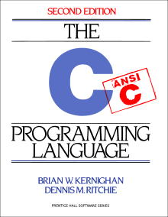

Some dark corners of C
-std=c99 -pedantic -Wall -Warn-me-harder
Rob Kendrick <rob.kendrick@codethink.co.uk>
Stolen from Rob Kendrick <rjek+dark corners@rjek.com>

Slide 3
Dark corner of C
Here it is!

Slide 4
Shadowy escape
int x = 42; int func() { int x = 3840; { return x; } }
int x = 42; int func() { int x = 3840; { extern int x; return x; } }
Returns 3840
Returns 42
Notes:
Variable shadowing. "extern" means "get this symbol from the enclosing scope", not "get this symbol from some other link unit". That enclosing scope /may/ be another link unit.

Slide 5
Bizarre keyword reuse
void foo(int x[static 10]);
Passed array must be at least 10 entries.foo.c:8:2: warning: array argument is too small; contains 5 elements, callee requires at least 10 [-Warray-bounds]
void foo(char x[static 1]);
Free compile-time non-NULL check!foo.c:8:2: warning: null passed to a callee which requires a non-null argument [-Wnonnull]
Notes:
C99. Only very modern clangs seem to actually make use of it, sadly.

Slide 6
Warning: Don't breathe this
int x = 'FOO!';
Yes, single quotes.
Yes, that's right, it makes demons fly out of your nose!
(On my system, 1,179,602,721.)
If you do this, I will find you.
Notes:
'FOO!' literally gets loaded into the four bytes of the register. Maybe sometimes useful in enums, but only if you know the size of the enum type.

Slide 7
[ ] is just + in disguise
assert(spong[x] == x[spong]);
assert(spong[2] == 2[spong]);
d = "0123456789abcdef"[n];
d = n["0123456789abcdef"];
Notes:
Although one side of the + must be a pointer type. Remember that adding 1 to a pointer does not mean to move the pointer on one byte in memory!

Slide 8
Pointer aliasing
void foo1(int *x, int *y, int *z) { *x += *z; *y += *z; }
movl (%rdx), %eax addl %eax, (%rdi) movl (%rdx), %eax addl %eax, (%rsi) ret
Compiler doesn't know that *z won't also be *x, so loads it twice :(
Notes:
x, y and z might all point to the same data, or there might be another thread...

Slide 9
Pointer aliasing: Fixed?
void foo2(int *x, int *y, int *z) {
int w = *z; *x += w; *y += w; }
movl (%rdx), %eax addl %eax, (%rdi) addl %eax, (%rsi) ret
Only one load, at the cost of beauty.

Slide 10
Pointer aliasing: Fixed!
void foo3(int *x, int *y,
int * restrict z) { *x += *z; *y += *z; }
movl (%rdx), %eax addl %eax, (%rdi) addl %eax, (%rsi) ret
'restrict' means we promise not to mess about.

Slide 11
Counting up ...
int fact1(int n) { int i, fact = 1; for (i = 1; i <= n;
i++) fact *= i; return fact; }
fact1: movl $1, %eax testl %edi, %edi jle .exit xorl %ecx, %ecx .loop: incl %ecx imull %ecx, %eax cmpl %ecx, %edi jne .loop .exit ret

Slide 12
... vs counting down
int fact2(int n) { int fact = 1;
if (n == 0)
return fact; do fact *= n; while (--n != 0);
return fact; }
fact2: testl %edi, %edi movl $1, %eax je .exit .loop: imull %edi, %eax subl $1, %edi jne .loop .exit: ret
Notes:
Although this version has different behavior when N == 0

Slide 13
const confusion
const int foo = 10;
const int *foop = &foo;
"Constant" integer foo with value 10.
And a "constant" pointer to it?
int i = 20;
foop = &i;
Oops. const binds left. But if there's nothing to its left, it binds to the right.

Slide 14
Munchy munchy.
z = y+++x;
The C specification says that when there is such an ambiguity, munch as much as possible. (The "greedy lexer rule".)
z = y++ + x;

Slide 15
Munchy munchy. Again.
z = y+++++x;
Alas, not
z = y++ + ++x;
But
z = y++ ++ +x;
Parser go boom.

Slide 16
C keywords
auto break case char const continue default do
double else enum extern float for goto if int
long register restrict return short signed sizeof static struct switch typedef union unsigned void volatile while
Wait, what? auto is a bizarreness left over from B. The only place it's valid, it's also the default. And that's to say a variable should be automatically managed, ie, placed on the stack. static is its antonym. Ish.

Slide 17
Smallest C program
What's the smallest C program that will compile and link?
main;
Alas it produces a warning. So we can do this:
int main;
(Don't run this.)

Slide 18
Global variables are filthy
foo1.c:
int x;
foo2.c:
int x;
int main() { printf("%d\n", x); }
$ gcc -o foo foo1.c foo2.c
$ echo $?
0
Notes:
Prints 0

Slide 19
Global variables are filthy
foo1.c:
int x = 42;
foo2.c:
int x;
int main() { printf("%d\n", x); }
$ gcc -o foo foo1.c foo2.c
$ echo $?
0
Notes:
Prints 42

Slide 20
Global variables are filthy
foo1.c:
int x = 0;
foo2.c:
int x = 0;
int main() { printf("%d\n", x); }
$ gcc -o foo foo1.c foo2.c
/tmp/ccx4aT9m.o:(.bss+0x0): multiple definition of `x'

Slide 21
// comments are evil
int foo() { int a = 10, b = 2; return a //* //*/ b ; }
C89: 5
C++: 10
C99: 10

Slide 22
Portable lossless floats
printf("%a\n", 1.2345);
0x1.3c083126e978dp+0
printf("%f\n",atof("0x1.3c083126e978dp+0"));
1.234500

Slide 23
Ruin somebody's day
What would you sneak into somebody's headers to drive them mad?
#define struct union
#define else
No valid C program will fail to compile with these.

Slide 24
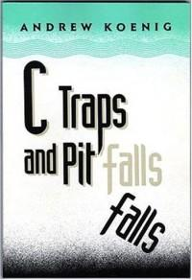
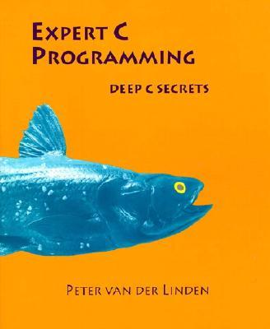
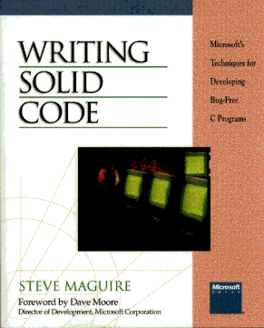
Recommended reads
Sadly very few modern books on the subject of C :(

Slide 25
Thanks for ideas/input...
David Thomas
Daniel Silverstone
Clive Jones
Peter Van Der Linden
Erlend Hamberg

